Slide 1


Slide 2
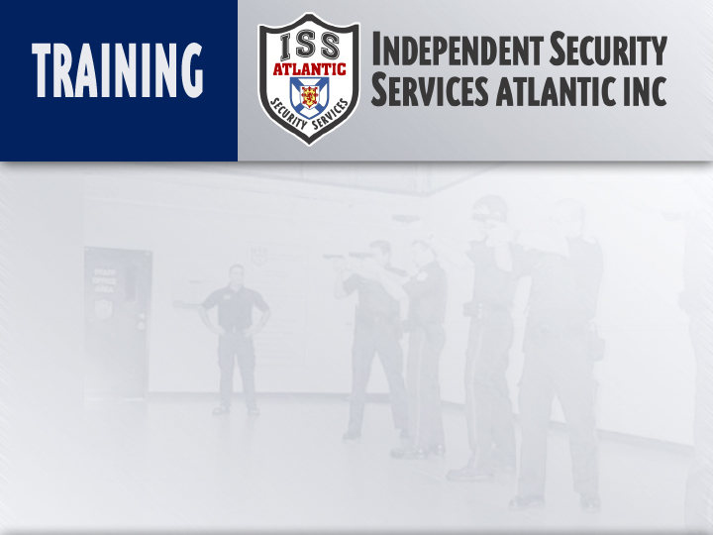
Nova Scotia Neck Restraint
(NSNR)
Instructor:
Date

Slide 3
  Objectives:
    Examine the NS DOJ policy on NSNR
    Identify the force options context of NSNR
    State the normal times to establish control and
  normal recovery times
    Examine when an unconscious subject should be
    released from restraint and handcuffed
    Explain the differences between the NSNR and
    respiratory restraints

Slide 4
Objectives: (Cont’d)
  Demonstrate NSNR system from clinical and rear takedown positions
  Demonstrate the “coaching” option
  Demonstrate the brachial stun option
Method Of Instruction:
  Lecture development, practical application, written exam
Training Aides:
  Presentation, practical applications, written exam
Pen and paper are required

Slide 5
Introduction
Undoubtedly one of the most controversial topics in modern policing is the use of neck restraints in dealing with violent subjects.
Neck restraints are often confused with choke holds and have been abused through training ignorance and misinformation.
When used properly the NSNR is one of the most reliable subject control techniques developed for dealing with high levels of resistance.

Slide 6
Introduction
A common misconception with neck restraint systems is that it is a “choke hold” (such as the Bar-Arm choke/respiratory technique) which uses the principals of pain compliance and strangulation to gain control.
When a choke hold is applied it compresses the trachea with the forearm, and the oxygen supply to the body is cut off.
When used improperly it can cause breakage or swelling of the trachea, which if not properly treated, can cause death.
The NS DOJ does not teach or condone the use of respiratory restraint control tactics.

Slide 7
Introduction
The NSNR is based on vascular principals, differing from respiratory restraints in that compression is applied and directed laterally with no direct pressure on the trachea.
The vascular system supplies all organs with oxygenated blood and will always maintain a constant supply.
If at any time the blood pressure on the brain is reduced, the lack of oxygenated blood will cause unconsciousness.
Notes:
Not interrupting air flow, interrupting blood flow

Slide 8
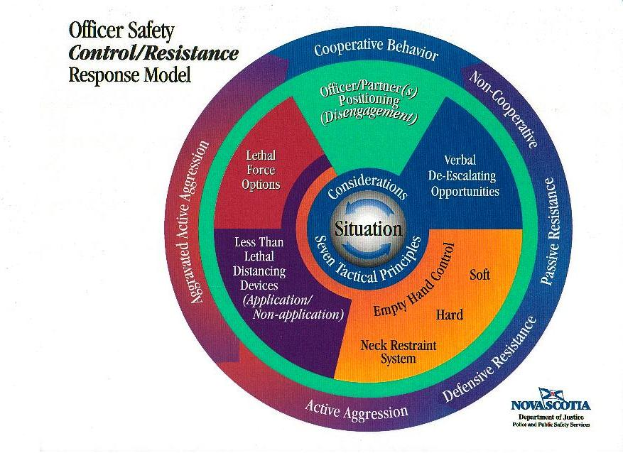
The NSNR is classed as the highest level of Empty Hand Control
To LEGALLY use this technique, 4 criteria must be met:

Slide 9
A violent person has to be immediately controlled.

Slide 10
No lower level of force would be appropriate given the situation.

Slide 11
No reason to believe the subject will suffer serious injury.

Slide 12
The officer applying the technique has been properly trained.

Slide 13
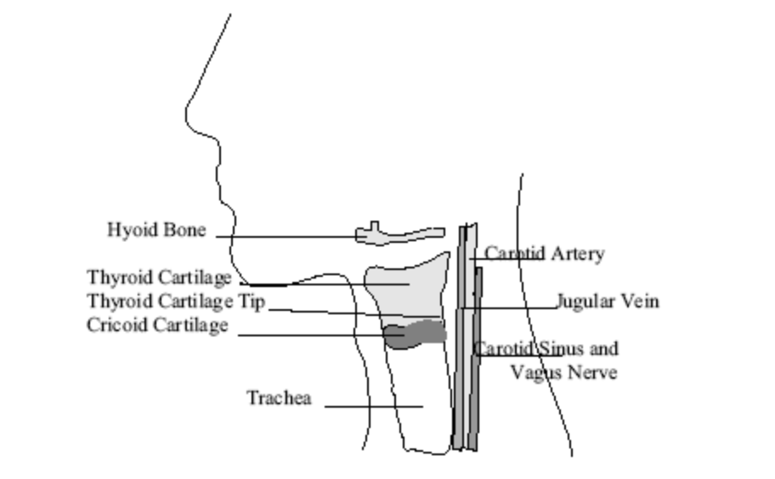
NSNR: How it works
Veinous compression:
Compression of veins in neck area
Veins bring blood out of the brain
Thin consistency compared to arteries
Compression causes vascular congestion of vascular bodies

Slide 14
NSNR: How it works
2. Vagus stimulation:
Nerve runs parallel to carotid artery
Regulates heart rate
Stimulate & slows down heart rate
Lack of oxygenated blood to brain

Slide 15
NSNR: How it works
3. Carotid compression:
Run along the side of the neck
Supply 70-80% of blood to brain
Other 20-30% by vertebral arteries (back of neck)
Difficult to depress with forearm

Slide 16
NSNR: How it works
4. Valsalva maneuver:
Pressurization of chest cavity
By holding breath & contracting of diaphragm
Results in limitation of oxygenated blood to the brain

Slide 17
NSNR: Effects and risks
Applies pressure to the LATERAL aspects of the neck.
When done correctly, there is a low risk of injury.
Effects include:
  Unconsciousness
  Loss of voluntary muscle control
  Loss of voluntary smooth muscle (bowel, bladder) due to stimulation

Slide 18
Respiratory Restraints: Effects and risks
Direct pressure to trachea (can cause breakage or swelling)
Pain compliance
Strangulation (oxygen depravation)
High risk of death
Not recommended as a viable control technique
Can cause damage to the neck and surrounding tissue/cartilage

Slide 19
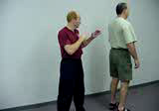
Concept of Application
Only apply pressure from directly behind
Subjects balance is broken (decentralized)
Restraint is applied dynamically
Subject controlled to ground

Slide 20
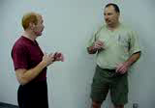
Concept of Application
Subject rendered (CONTROLLED) unconscious 4-7 seconds
Subject is IMMEDIATELY handcuffed (Do not kneel on the small of the subjects back)
Place the subject in the recovery position (recovery in 5-30 seconds)

Slide 21
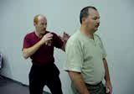
Concept of Application
Check breathing and pulse, when appropriate
Loosen clothing – CPR
Call EMS
IF the subject remains unconscious for more than 30 seconds, medical attention must be provided as soon as possible.

Slide 22
Follow up Procedures
Medical attention provided, if required
Ensure in-custody subjects are monitored, notify the police (who will notify booking staff)
Document the NSNR in your notebook
Fill out Use of Force Report

Slide 23
Technique Considerations
Clinical Position
  Subject is seated
  Recommend dominant side (can be applied from both sides)
  Arm encircles neck
  Shoulder contacts one side of the neck
  Lower 2-3 inches of the forearm contacts the other side
  Contact just below mandible

Slide 24
Technique Considerations
Clinical Position
  Palm of encircling arm is down (make a fist)
  Elbow of encircling arm is centered on the subjects sternum
  Neck brace principle (stabilize to the rear)
  Free hand used to generate lateral pressure on the fist.

Slide 25
Technique Considerations
Clinical Position
  Elbow presses into the subject’s sternum
  Subjects controlled until all resistance stops
  Follow up control/procedure

Slide 26
Summary
We have learned the 4 criteria that must be met in order to apply the NSNR
The NSNR is the highest level of Empty Hand Control
We have learned how and why the NSNR works as well as why we DO NOT use respiratory neck restraints
We have learned application techniques and follow up procedures

Slide 27
Take a break and then lets go practice!

